Slide 1
vt01 _ jj_4wire
data from 20191125 and 20191127

Slide 2
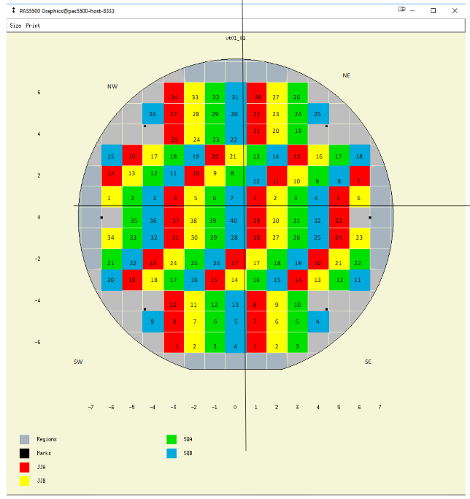
On each die, there are south- and east-side devices
East has 2.05 squares of resistance
South has 1.15 squares of resistance
Data taken from these two die

Slide 3
die 11, jj 4-wire measurements

Slide 4
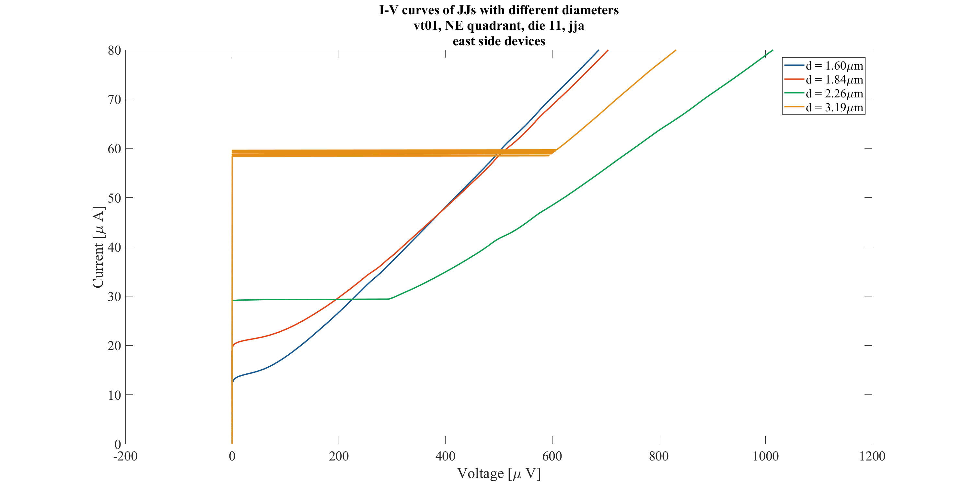

Slide 5
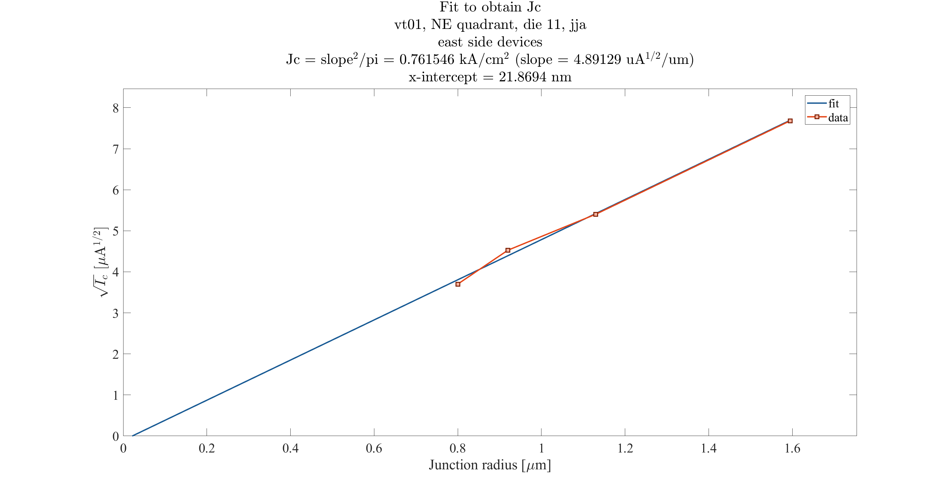

Slide 6
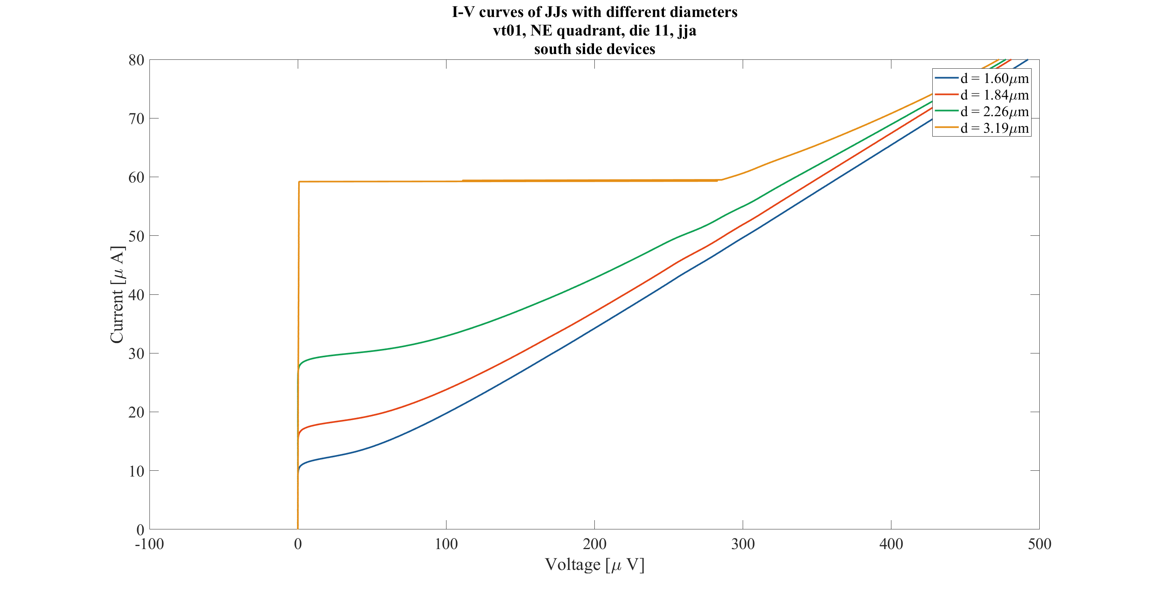

Slide 7
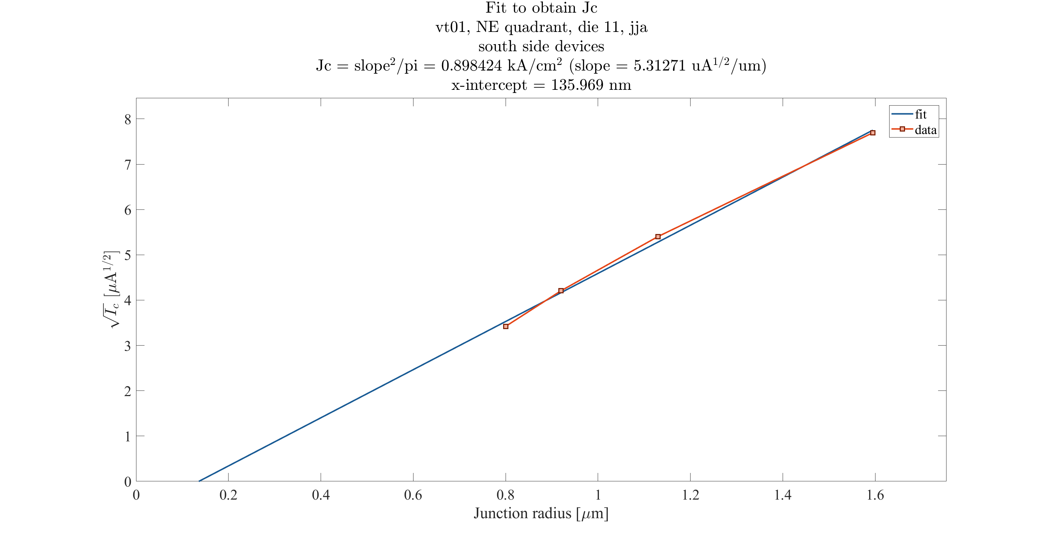

Slide 8
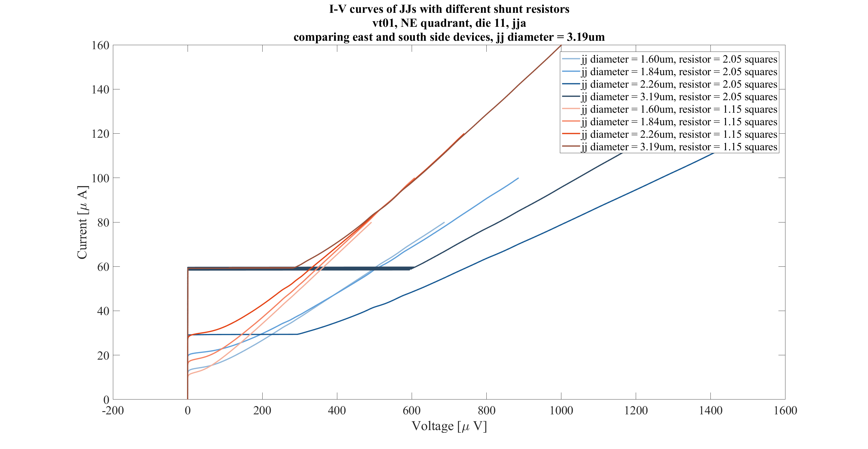

Slide 9
die 15, jj 4-wire measurements

Slide 10
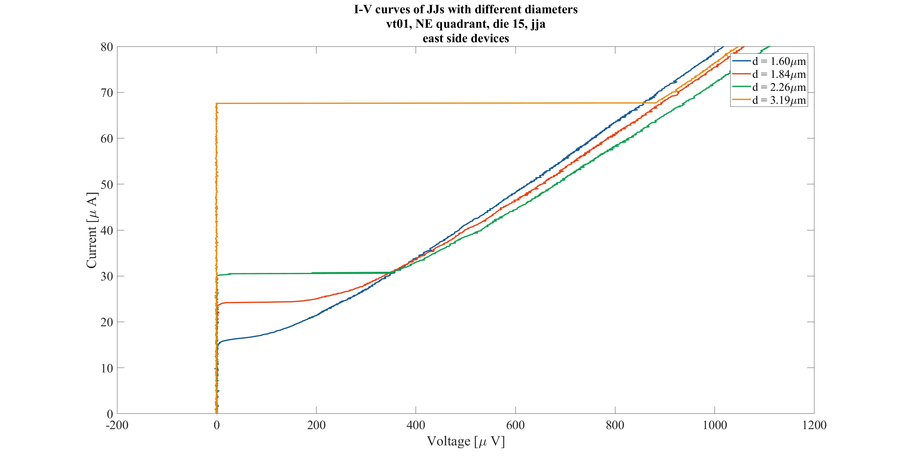

Slide 11
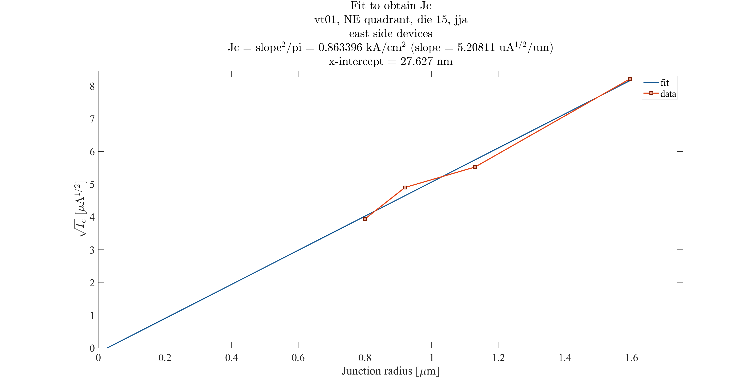

Slide 12
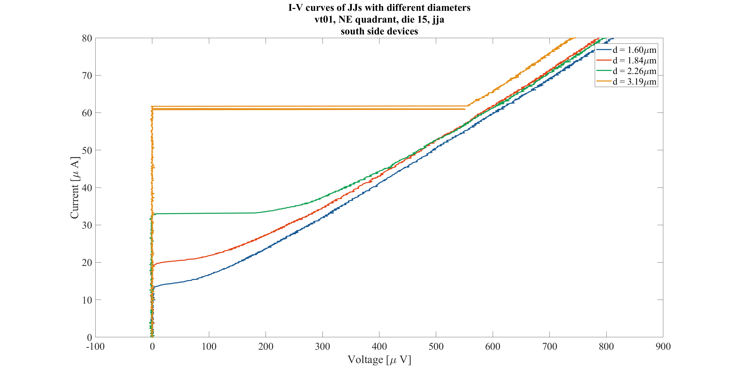

Slide 13
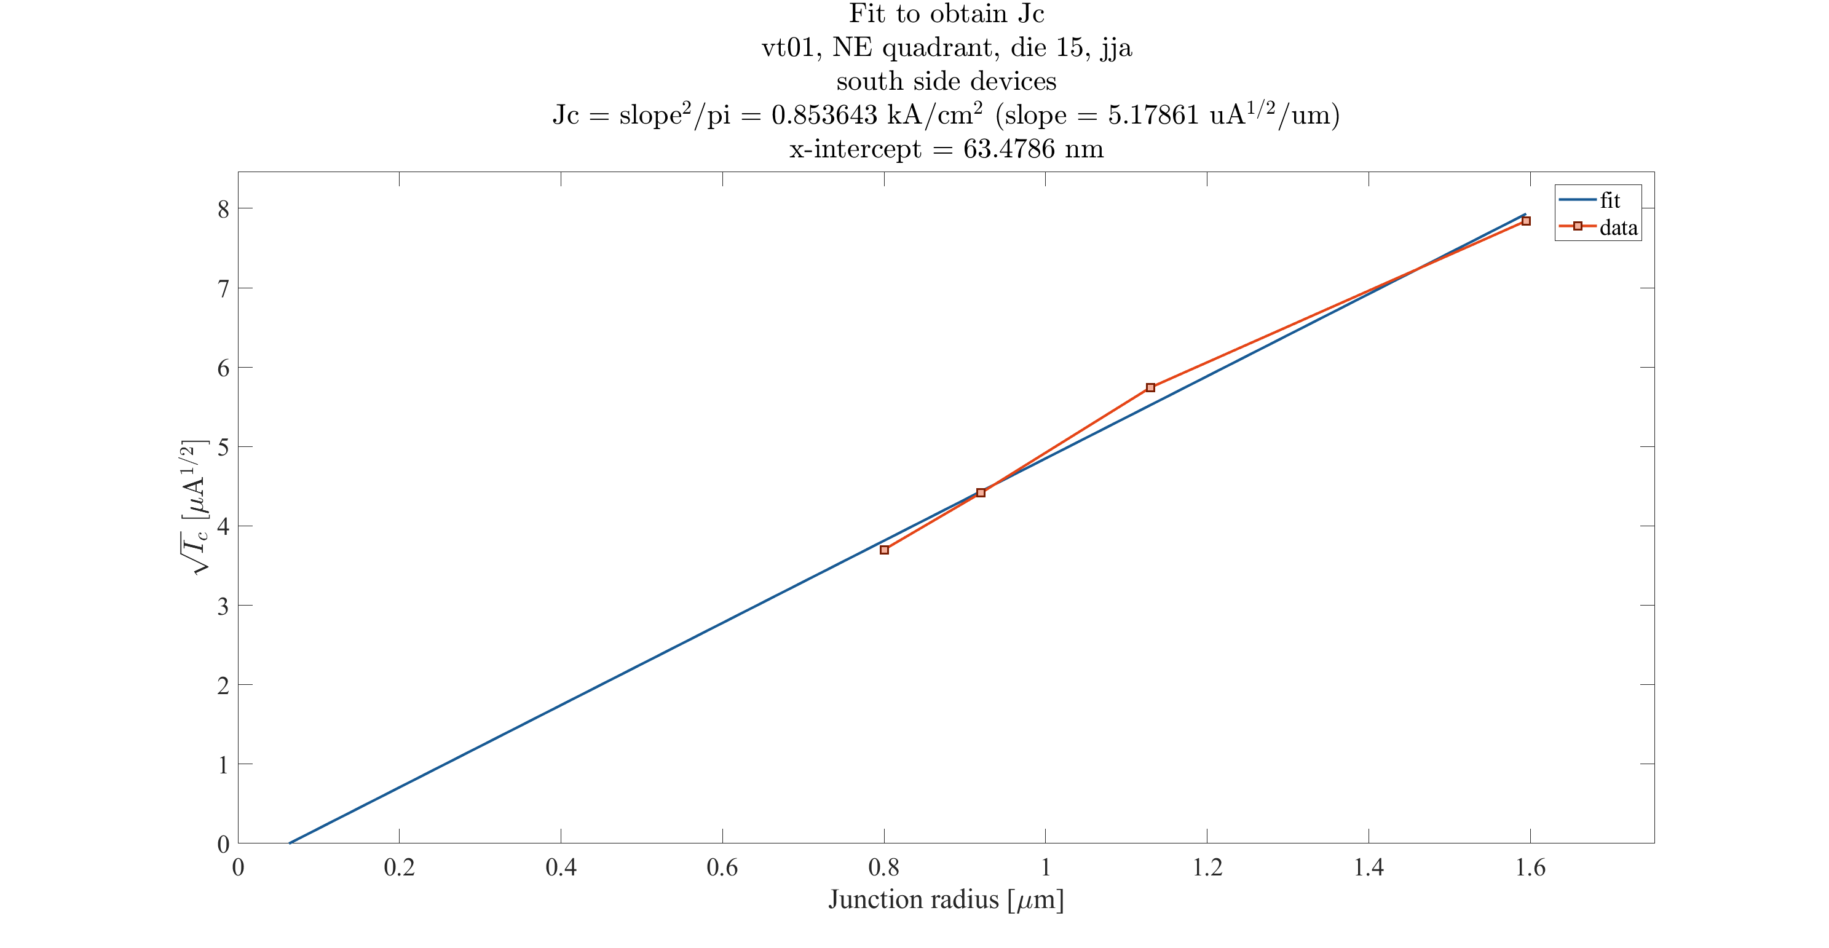

Slide 14
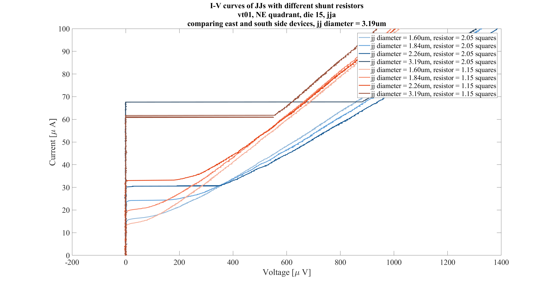

Slide 15
comparing die 11 and 15, jj 4-wire measurements

Slide 16
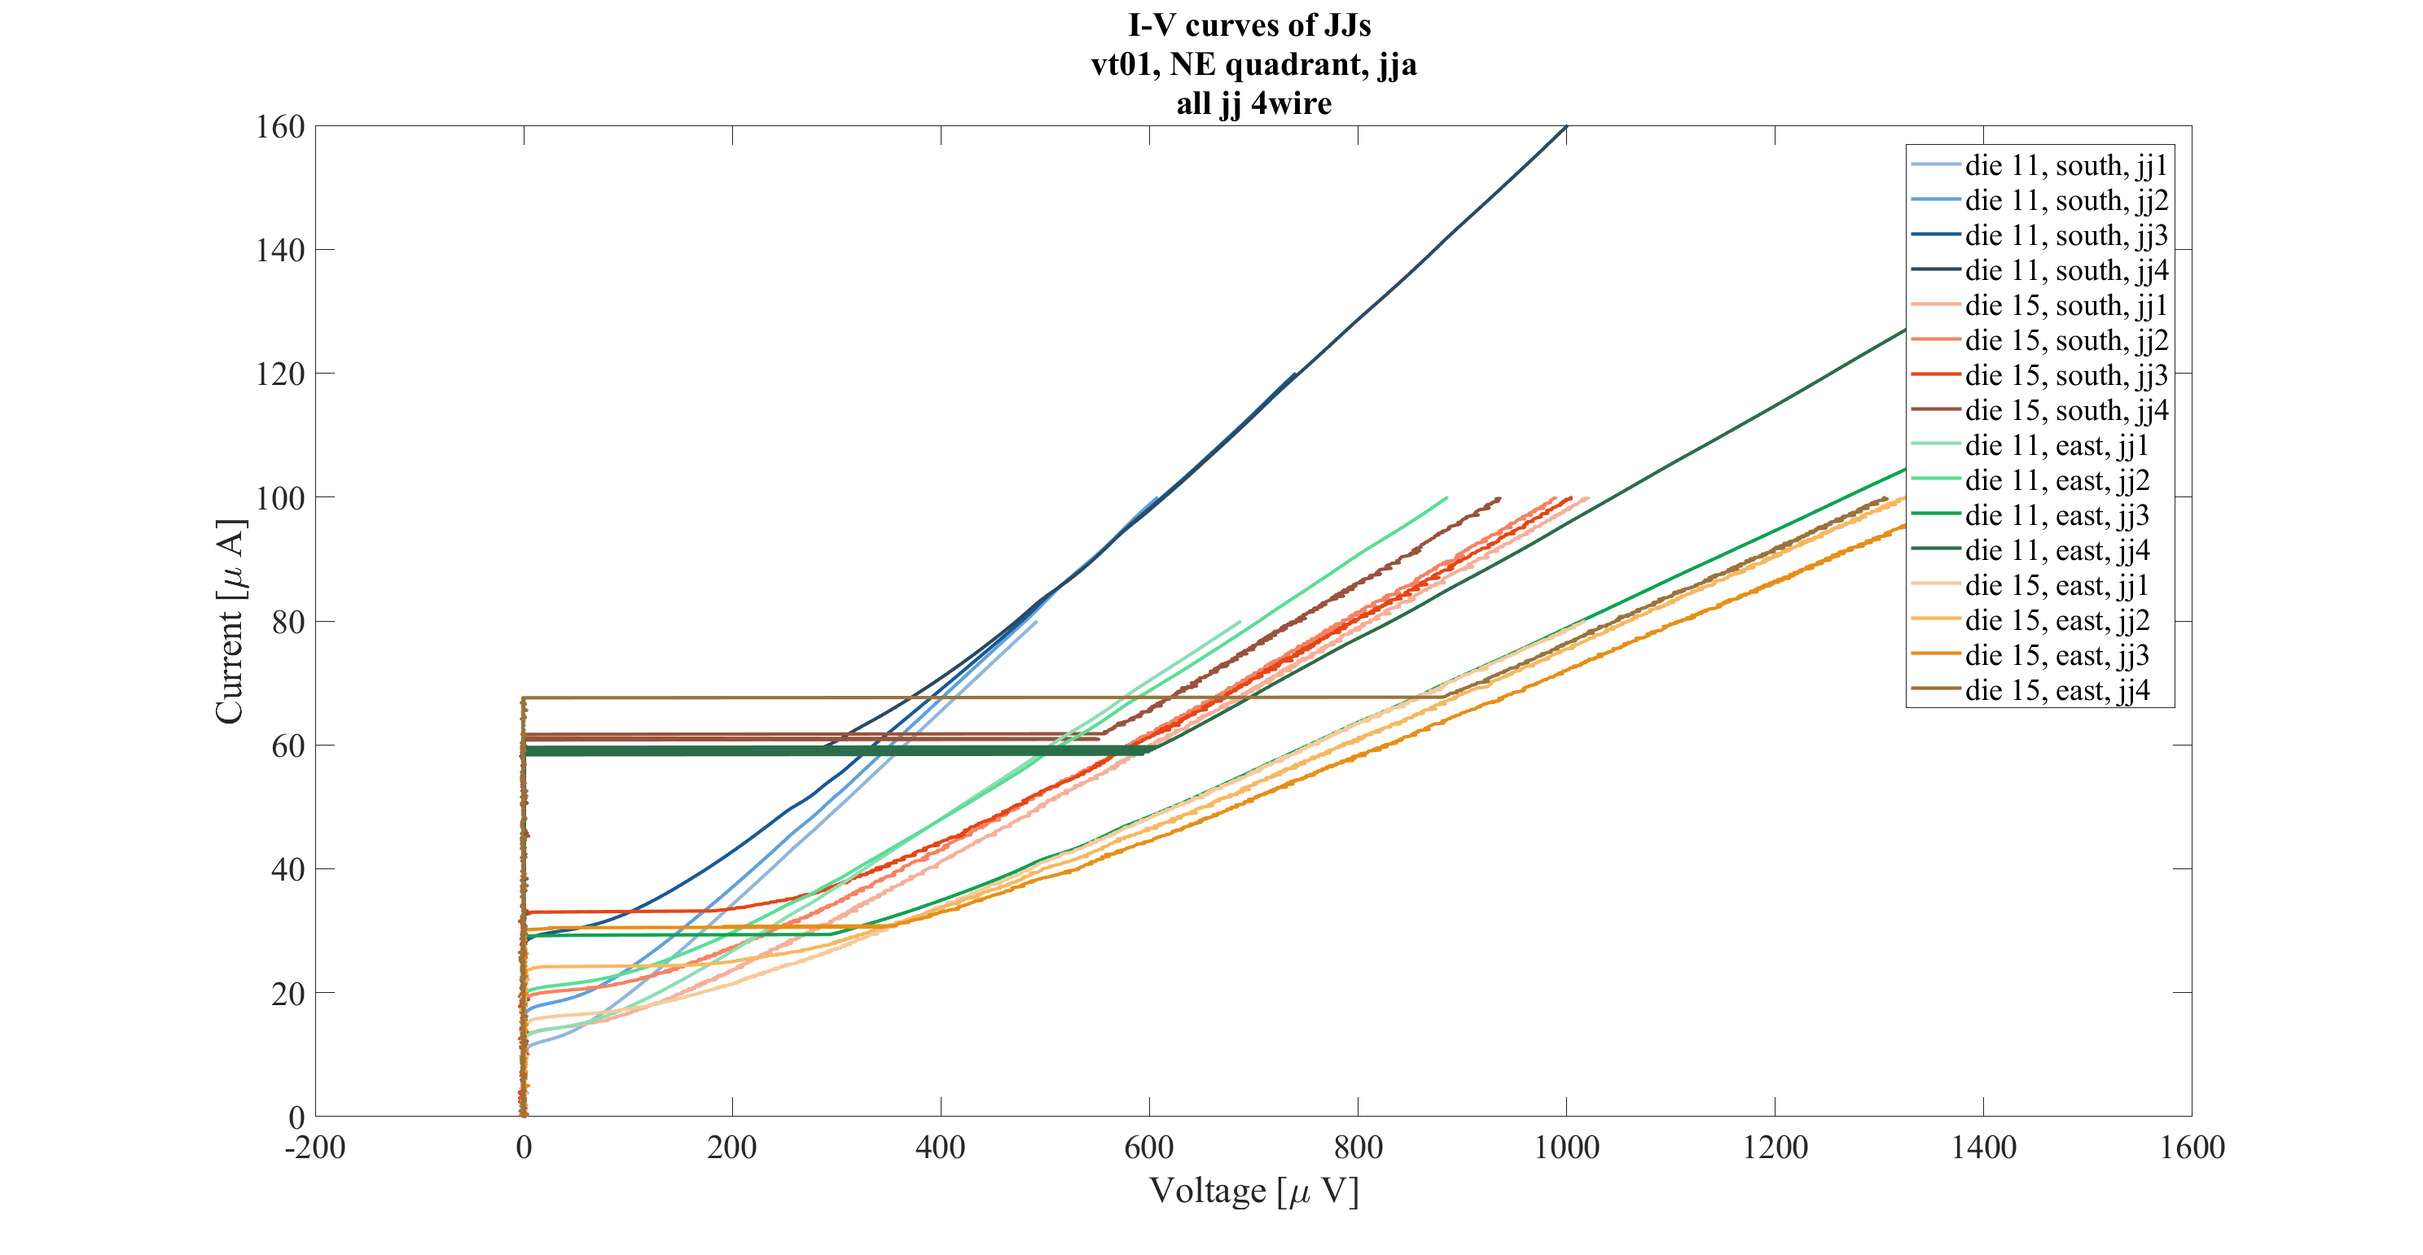
East has 2.05 squares of resistance
South has 1.15 squares of resistance

